Slide 1
The Canning of Food
Chapter 27

Slide 2
The Canning of Food
Objectives
Explain the purpose of different equipment used in home and commercial canning.
Explain when the hot-pack and cold-pack methods are appropriate to prepare food for canning.
Compare the two processing methods for home canning foods.
Explain why different foods require different methods of processing.
Describe the role of conduction and convection in canning.
Compare different commercial canning methods.
Explain how to avoid C. botulinum poisoning.
Summarize ways to make canned foods part of a healthful diet.
Vocabulary
Agitation retorts
Aseptic processing
Canning
Cold-pack
Cold-point
Hot-pack
Pouch canning
Pressure processing
Raw-pack
retort canning
Retorts
Water-bath processing

Slide 3
Discovery of Canning
1775 Napoleon ordered a 12,000 franc prize for anyone who could figure out how to preserve food from one harvest to the next.
1809 Nicolas Appert a candy maker unveiled his technique for preserving foods. Heating glass bottles and sealed with a cork.
Within a year, Peter Durand patented the tin canister
Canning, the process of preserving food by heating and sealing it in containers for storage.

Slide 4
Canning 101
(7:05)
http://www.youtube.com/watch?v=e5q1T7bKoxQ

Slide 5
Canning - Raw Pack vs. Hot pack
(9:30)
http://www.youtube.com/watch?v=ViGmNiHUjAk
Raw-pack – uncooked food is placed in the container
Cold-pack- another name for raw pack
Hot-pack – food is heated in syrup, water or juice and packed into a container while still hot

Slide 6
Water-Bath Processing
3:14
http://www.youtube.com/watch?v=V1jpyXPdCRE
Water-bath – containers of food are heated in boiling water in a canning kettle

Slide 7
Pressure Processing
(8:28)
http://www.youtube.com/watch?v=KrBtZ7ZgPIk
Pressure processing – containers of food are heated under pressure in a pressure canner

Slide 8
Processing Times
Amount of time needed depends on the food and the containers
Large containers need more time
Glass container must be processed longer then metal ones

Slide 9
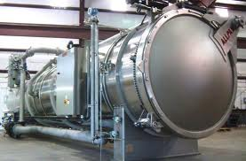
Commercial Canning
Retort Canning – pressure processing carried out by commercial food canners.
Retorts are huge pressure canners used commercially

Slide 10
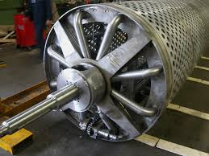
Agitation Retorts
Agitation retorts are canners that mechanically increase the movement of the food to shorten processing time

Slide 11
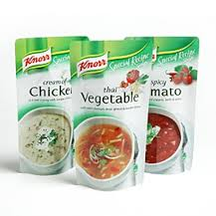
Pouch Retorts
Pouch canning – similar to retort canning except hat flexible tin packages replace cans and jars

Slide 12
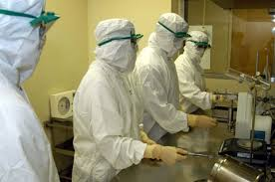
Aseptic Processing
Aseptic processing – food is first sterilized by heat and then placed in sterilized containers

Slide 13
Aseptic Processing
Advantages
Stored without preservatives at room temp.
Retains nutrients and flavor
Less expensive
Disadvantages
Total control of sanitary conditions must be maintained during processing

Slide 14
Botulism Poisoning
Proper canning is a matter of life and death
Clostridium botulinum causes botulism, the most serious foodborne illness known.
One cup of pure botulism toxin would be enough to kill every human on earth

Slide 15
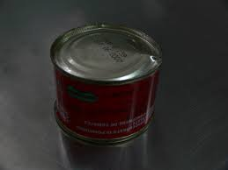
Avoiding Botulism
Don’t eat foods stored or not prepared properly
Bulging or puffy cans – throw out
Cracked jars – throw out
Loose lids – throw out

